Slide 1
North Lake County EMS
May 17, 2022
Ballot Measure 19-36
North Lake Emergency
Service District

Slide 2
“North Lake Emergency Service District”
History
The NL-ESD Board
What we do
The area we service
Why the Ballot Measure
6. How we got to this place

Slide 3
NLC EMS History
NLC-EMS had been a VOLUNTEER organization for over 60 years
NL County Disaster Unit came on line in 1959

Slide 4
NLC EMS History
NL EMS became an official non-profit in October, 1983
All of our staff have regular day jobs; farm, drive truck, teach, own other businesses, etc.
They are volunteers.

Slide 5
“NL Emergency Service District” - Board Members
Daniel Miles, Chairman
Buck Church, Vice Chair
Dave Elmore, Board Member
Katie Wesler, Board Member
Blaine Nofziger, Board Member
Past President
Patty Effingham, Secretary/Treasurer

Slide 6
Current “North Lake – Emergency Service District” Officers
Sue Ingalsbe, EMS Director
Deanna Roberts, Training Officer & Maintenance Officer
Nathan Church, Communications Officer
Physician Advisor – Dr Todd Tornay

Slide 7
Current Staffing:
1 local active volunteer Intermediate responder
2 paid on-call, local active EMT Basics
6 active volunteer drivers, four reserves
2 ambulances, a 1995 Ford and a 2012 Dodge

Slide 8
What we do “NL-Emergency Service District” Board of Directors
Procure and maintain essential equipment
Maintain a volunteer staff as available
Insure all aspects of operations are in accordance with legal guidelines

Slide 9
What We Do !
We respond to emergency calls within our area of coverage
Vehicle accidents

Slide 10
What We Do !
We respond to emergency calls within our area of coverage
Industrial / Farming accidents
Recreation (sand dunes)

Slide 11
What We Do !
We respond to emergency calls within our area of coverage
Coronary emergencies
School/student related emergencies

Slide 12
What we do! NL – Emergency Service District Board of Directors
Secure reimbursements from:
Insurance, Medicare, Medicaid, Veterans Association, etc. (may take 2-years to be reimbursed)

Slide 13
Emergency Service District Service Map

Slide 14
How We Got Here:
The Emergency Service District Board created an Ad Hoc committee over 5 years ago to study how to proceed and maintain services.

Slide 15
Ad Hoc Committee
The outcome of this committee was the recommendation to the ESD Board:
To pursue a tax base to sustain future operations.
This stabilizes revenue
Provides a paid staff
Insures long term operation

Slide 16
Ad Hoc Committee
The ESD Board has retained legal counsel:
Has guided us thru this process.
Our legal counsel represents over 100 other Special Taxing Districts
This process is specific and each step is directed by state law

Slide 17
From July 2020 to January, 2022 We are on the May 17, 2022 ballot
We worked with:
County Clerk
County Assessor
County Commissioners
Secretary of State
Our legal Counsel

Slide 18
Our population is steady but it’s projected to increasing at a gradual rate
A yes vote on this measure would result in continued staffing and service
A no vote would potentially result in cessation of these services

Slide 19
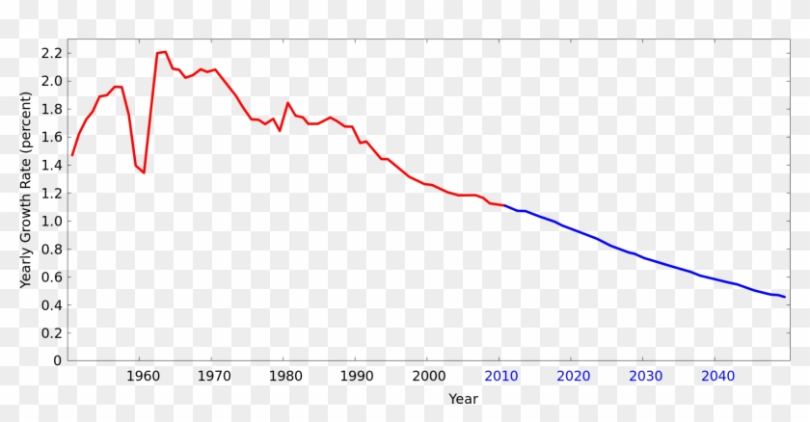
Our Staff
Our volunteer staffing has decreased significantly
We are experiencing greater difficulty meeting the emergency needs of our community as a volunteer entity

Slide 20
Our Staff
In 2009 we answered 105 calls w/ 21 personnel
In the last 2-years we have averaged 220 calls per year with 11 personnel in 2021.

Slide 21
Summary:
As population in the area increases:
The demand for emergency services has also increased.
The increase in demand coupled with insurance coverage restrictions, reduction in volunteerism, and increased operational costs now threaten NL ESD’s ability to remain solvent and provide its vital service.

Slide 22
Why the May 17, 2022 Ballot?
We are having difficulty maintaining a volunteer staff and providing services
We are experiencing greater difficulty operating from donations, grants and delayed reimbursements
We are experiencing difficulty meeting the overall emergency needs of our community as a volunteer entity

Slide 23
Taxation Information
$2.64 per $1000
$100,000 property will cost $264/year
$200,000 property will cost $528/year

Slide 24
Future Information
If voter approved – the North Lake Emergency Service District will have a 5-member Board of Directors
These positions will also be open for election on the May 17, 2022 Ballot. Any elector who lives within the proposed boundary may run for the board and guide the future of this valuable organization.
Staffing models (variations based on availability of personnel)

Slide 25
Future Information
Board positions numbered #1 - #5
3 positions will be for 4 years
2 positions will be for shorter periods (appearing on the 2023 ballot)

Slide 26
Questions??

